Slide 1
Institution Training – Minor Project Comprehensive Examination – Viva-Voce
VULNERABILITY ASSESSMENT AND PENETRATION TESTING ON API
Under the Guidance of
Dr.V.Usharani M.C.A., M.Phil., Ph.D.
Associate Professor
Department of Software Systems
PSG College of Arts & Science
Coimbatore
Presented By
DHARSHAN P
III M.Sc Software Systems
PSG College of Arts & Science
Coimbatore

Slide 2
Presentation Outline
INTRODUCTION
SYSTEM CONFIGURATION
MODULES
SYSTEM DESIGN
APPENDIX
CONCLUSION

Slide 3
INTRODUCTION
Penetration testing is an attempt to break into a system using methods and devices that real hackers use.
The main purpose of penetration testing is to discover as many existing vulnerabilities as possible and develop viable solutions to fix the problems and improve the overall security of the system.
Penetration testing and vulnerability assessment perform two different tasks within the same scope, but often with different results.
Each organization confirms that its security measures are working properly through vulnerability analysis and penetration testing.
Depending on the vulnerability, manual penetration testing or automated penetration testing can be performed.
The main aim of the project is to perform the web pen test with the given credentials and generate the necessary reports accordingly.

Slide 4
SYSTEM CONFIGURATION
HARDWARE SPECIFICATIONS :
PROCESSOR : Intel Core i5
RAM : 8 GB
CPU Clock Speed : 2.93 GHz and above
Hard Disk Drive : 320 GB and above
Hardware : Mouse & Keyboard

Slide 5
SYSTEM CONFIGURATION
SOFTWARE SPECIFICATIONS :
OPERATING SYSTEM : Windows 11,Kali Linux(VMware)
WORKSTATION :VMware
AUTOMATED TESTING TOOLS : POSTMAN, Burp suite
VULNERABLE API : CRAPI
SEMI-AUTOMATED TOOLS : OWASP ZAP, JWT_TOOL

Slide 6
MODULES
1. INFORMATION GATHERING
Information gathering is a critical initial phase in API penetration testing. The more comprehensive the information collected about the API, the better equipped you will be to identify vulnerabilities and potential exploits.
POSTMAN
Postman is used to send API requests, analyze responses, explore endpoints, validate authentication mechanisms, and identify potential vulnerabilities and data exposure.
BURP SUITE
Burp Suite is employed to inspect the API endpoints, helping to uncover valuable information about the API’s functionality and potential vulnerabilities.
2. VULNERABILITY ASSESSMENT
A vulnerability assessment evaluates the security weaknesses across the API and estimates the likelihood of an attack by malicious actors. This process generates detailed reports and outlines mitigation strategies.
•

Slide 7
ZAPROXY
Conduct a scan of the API using its IP address to provide results regarding vulnerability assessments.
REPORT GENERATION
Create a comprehensive vulnerability assessment report detailing findings and recommendations.
3. PENETRATION TESTING
This module involves executing various attacks to gain access to the API and simulate real-world scenarios that could compromise sensitive data. These tests help identify vulnerabilities and discover potential exploits within the API.
EXPLOITATION
Attempt to exploit the API to identify any backdoors or security flaws present.

Slide 8
4. REPORT GENERATION
In this module, the report generation in API penetration testing involves summarizing findings, assessing vulnerabilities, providing recommendations, and documenting testing scope and methodology to communicate security risks effectively to stakeholders.

Slide 9
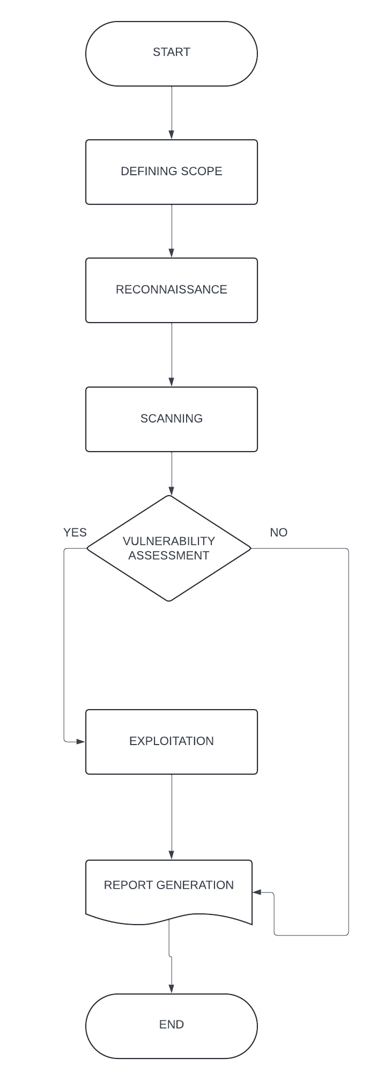
System design
SYSTEM FLOW DIAGRAM

Slide 10
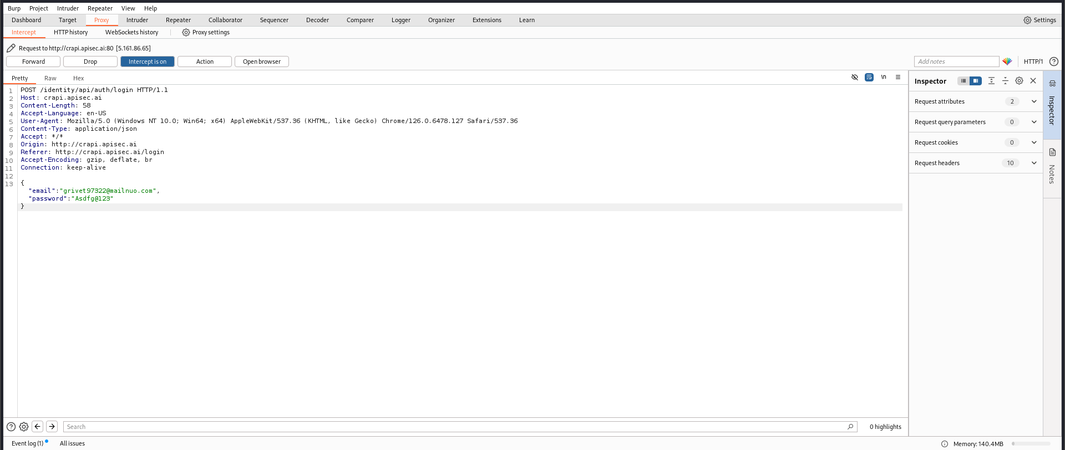
APPENDIX BURPSUITE INTERCEPT

Slide 11
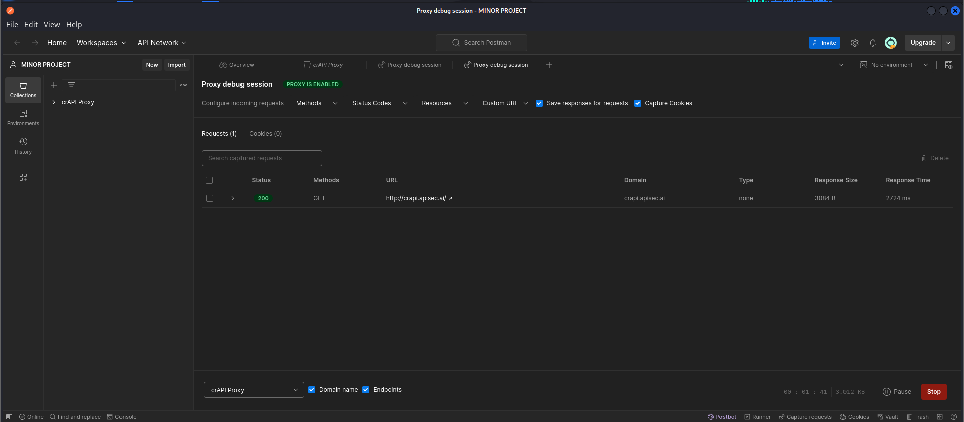
POSTMAN

Slide 12
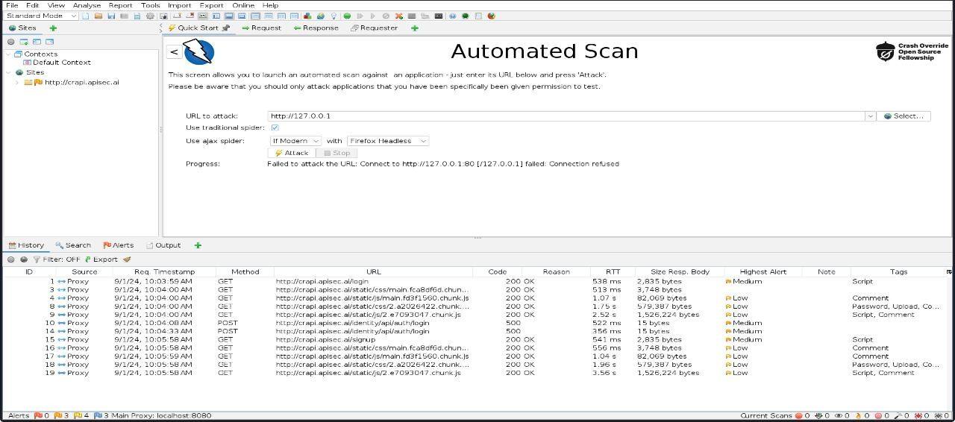
OWASP ZAP(ZAPROXY) SCANNING API

Slide 13
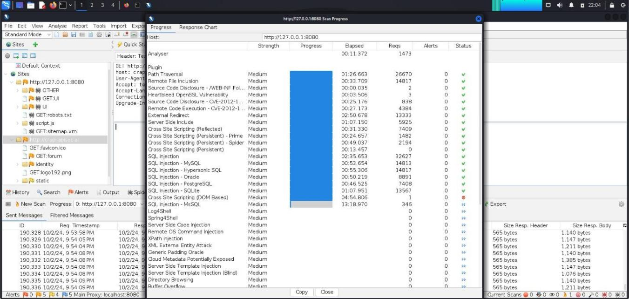
AUTOMATED SCAN REPORT

Slide 14
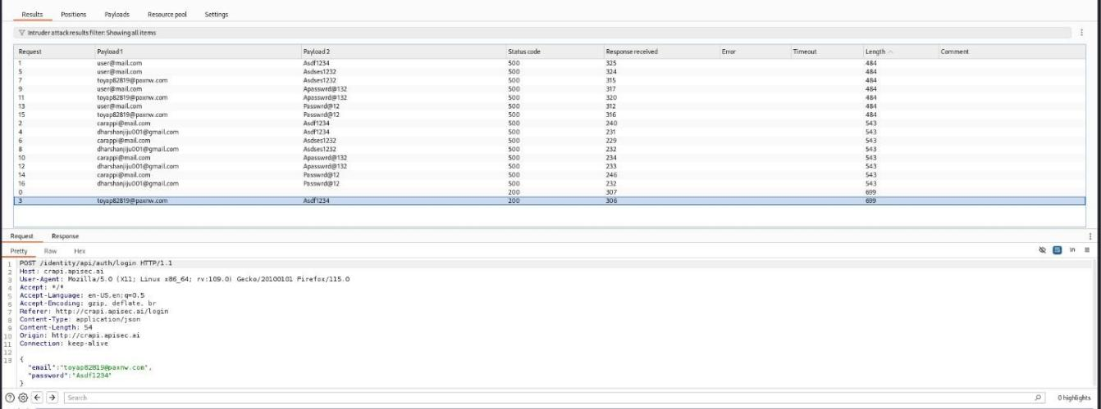
AUTHORIZATION ATTACK REQUEST:

Slide 15
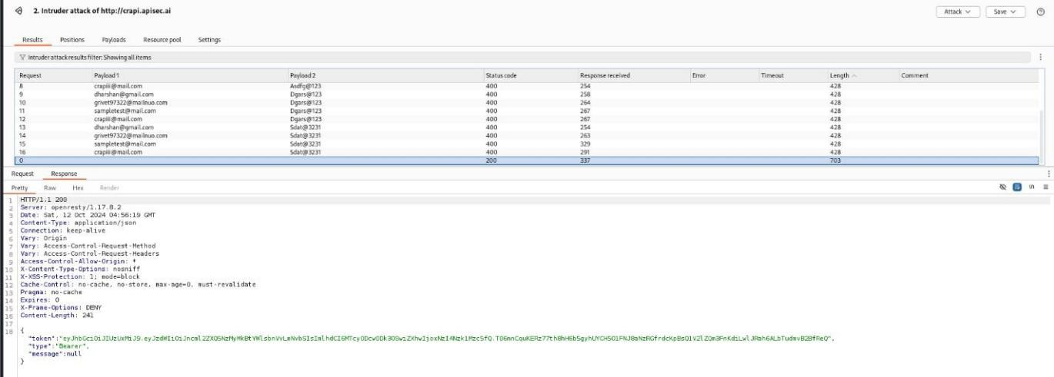
RESPONSE:

Slide 16
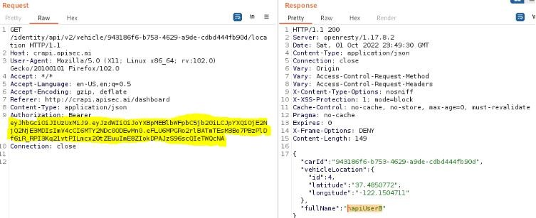
BROKEN OBJECT LEVEL AUTHENTICATION(BOLA)

Slide 17
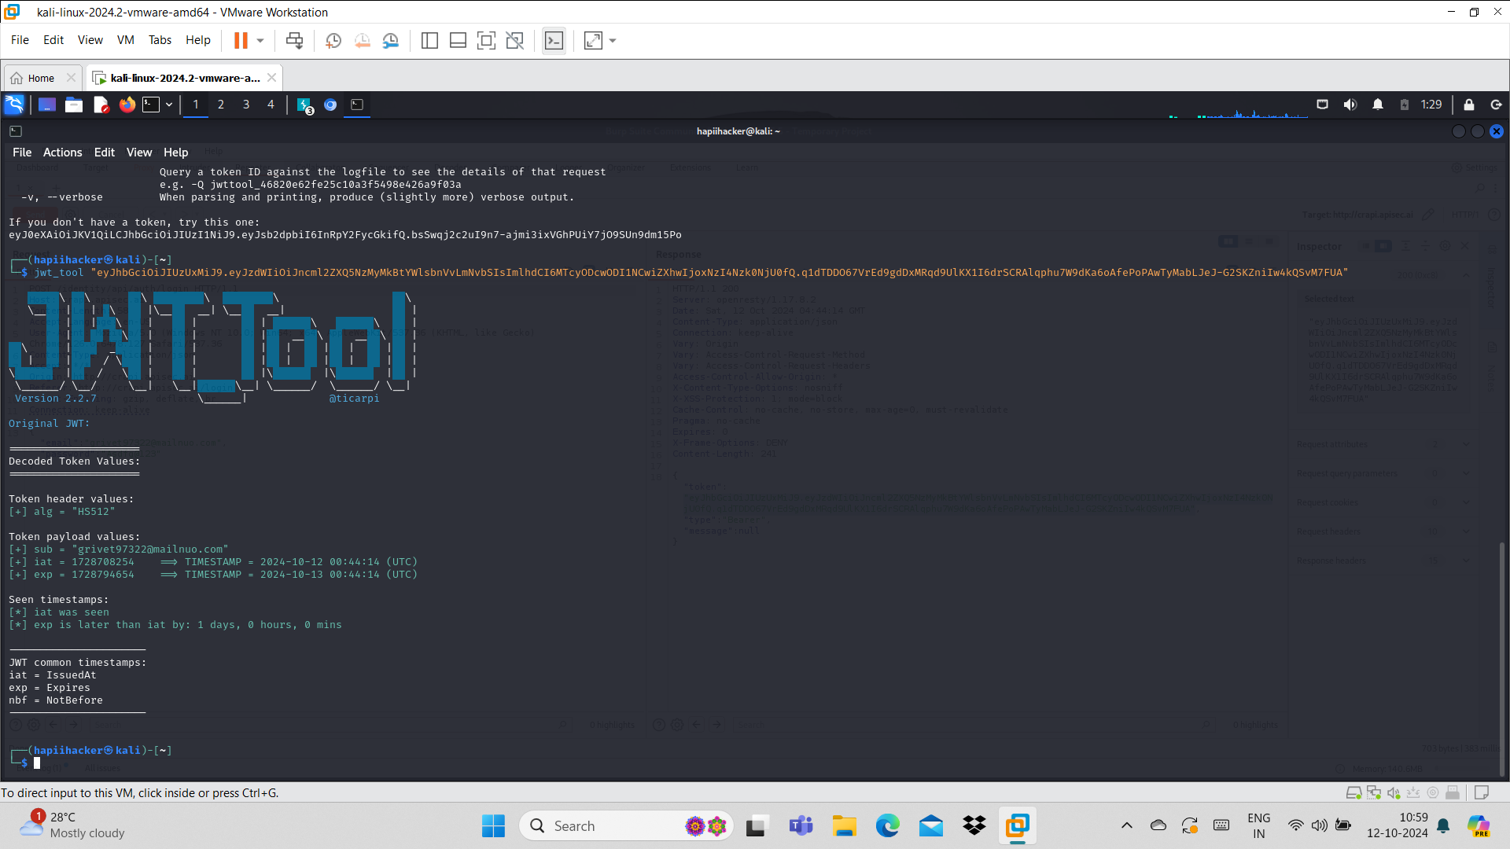
API TOKEN ATTACK

Slide 18
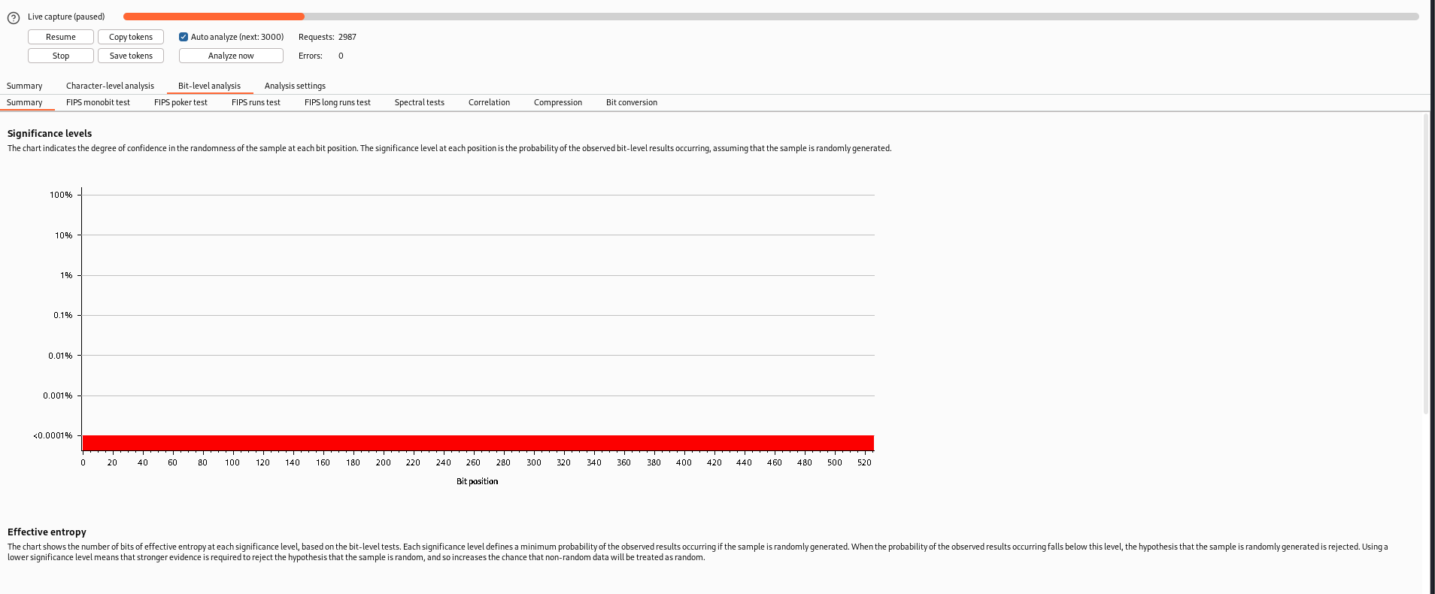
API TOKEN ANALYSIS

Slide 19
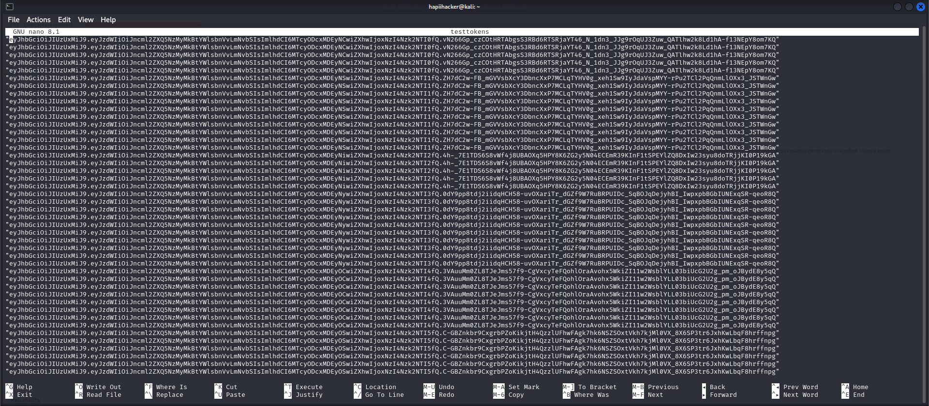
API TOKEN GENERATED DURING TOKEN ANALYSIS

Slide 20
CONCLUSION
VAPT is a highly compressible process. Various studies and methods are introduced.
The VAPT process identified some limitations related to processes and discussed some tools.
It will help you to find AUTHORIZATION, BOLA vulnerabilities which cannot be determined by manual testing.
Summarize VAPT is a very important process that helps identify security flaws.
More in the future look closely at various issues related to VAPT process such as newly discovered vulnerabilities.
Over with VA, we can identify vulnerabilities and then with PT we can fix the vulnerabilities.
Identification of factors prevent companies from adopting VAPT process to patch the flaws and secure them in the modern network era.

